Slide 1
Relational Database Management System
RDBMS
MySQL
PostgreSQL
SQL SERVER

Slide 2
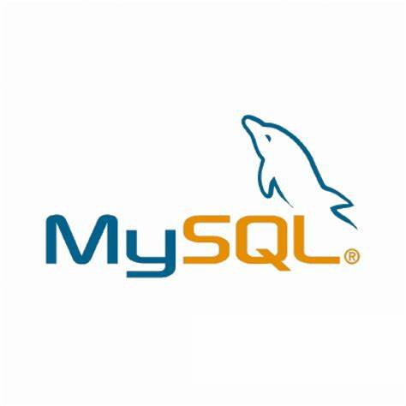
MySQL

Slide 3
Overview
MySQL is an open-source relational database management system (RDBMS). Its name is a combination of "My", the name of co-founder Michael Widenius's daughter and "SQL", the abbreviation for Structured Query Language. A relational database organizes data into one or more data tables in which data may be related to each other; these relations help structure the data.
An RDBMS like MySQL works with an operating system to implement a relational database in a computer's storage system, manages users, allows for network access and facilitates testing database integrity and creation of backups.
MySQL is free and open-source software under the terms of the GNU General Public License, and is also available under a variety of proprietary licenses.

Slide 4
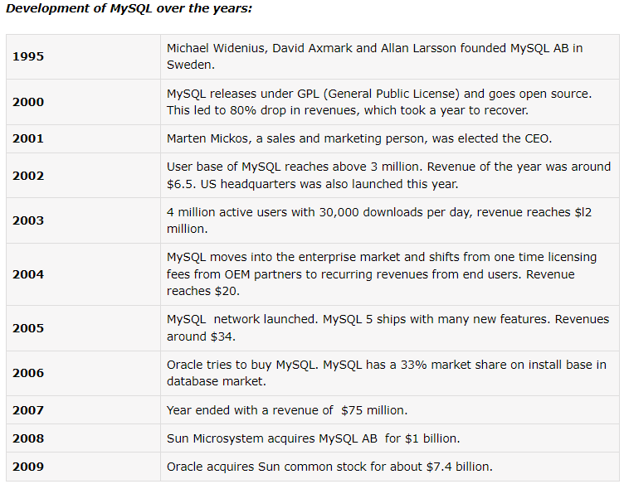
History

Slide 5
Features
Cross-platform support.
Stored procedures, using a procedural language that closely adheres to SQL/PSM.
Triggers, cursors…
Online Data Definition Language (DDL) when using the InnoDB Storage Engine.
Information schema.
Performance Schema that collects and aggregates statistics about server execution and query performance for monitoring purposes.

Slide 6
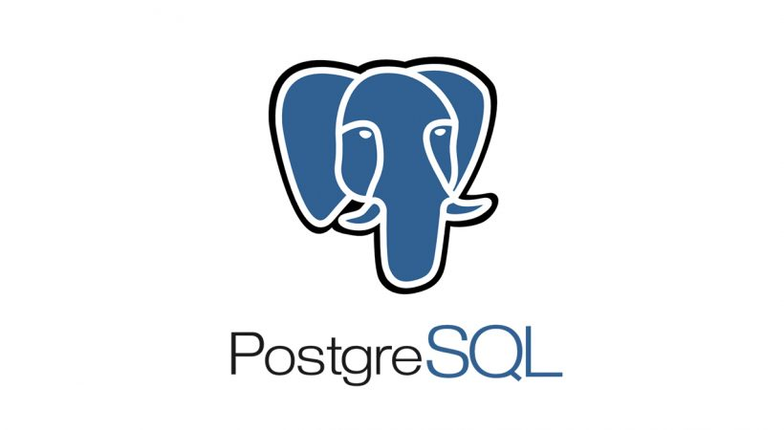
PostgreSQL

Slide 7
Overview
PostgreSQL, also known as Postgres, is a free and open-source relational database management system (RDBMS) emphasizing extensibility and SQL compliance. It was originally named POSTGRES, referring to its origins as a successor to the Ingres database developed at the University of California, Berkeley.
In 1996, the project was renamed to PostgreSQL to reflect its support for SQL. After a review in 2007, the development team decided to keep the name PostgreSQL and the alias Postgres.
PostgreSQL is designed to handle a range of workloads, from single machines to data warehouses or Web services with many concurrent users. It is the default database for macOS Server and is also available for Windows, Linux, FreeBSD, and OpenBSD.

Slide 8
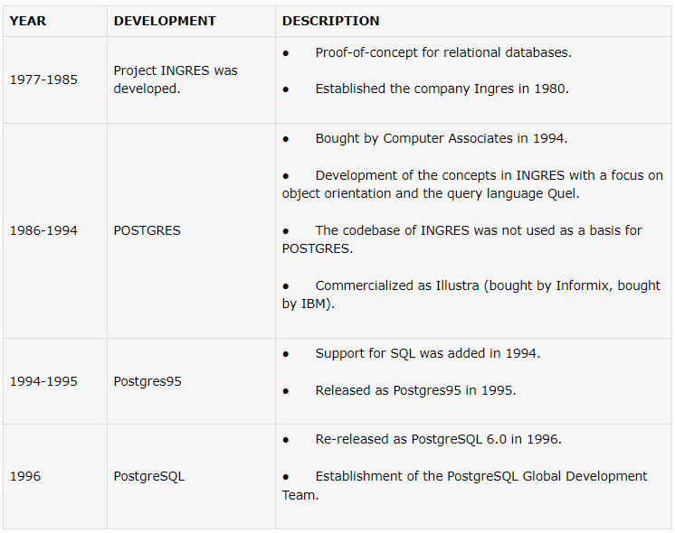
History
PostgreSQL is currently the most advanced open-source database available in the world. It was started in 1986 to overcome the problems of the contemporary database system. It was created by a computer science professor named Michael Stonebraker at UCB and was originally called Postgres, as it was started as a follow-up project and a post-Ingres project.

Slide 9
Features
Runs on all major operating systems including Linux, UNIX and Windows.
Supports text, images, sounds, and video.
Includes programming interfaces for C / C++, Java, Perl, Python, Ruby, Tcl and Open Database Connectivity (ODBC).
Supports many features of SQL including some advanced features.
A table in PostgreSQL can be set to inherit their characteristics from a “parent” table.
To add additional functionality to PostgreSQL, several extensions can be installed.

Slide 10
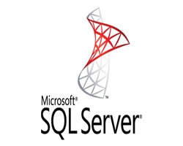
SQL SERVER

Slide 11
Overview
Microsoft SQL Server is a relational database management system developed by Microsoft. As a database server, it is a software product with the primary function of storing and retrieving data as requested by other software applications which may run either on the same computer or on another computer across a network (including the Internet).
Microsoft markets at least a dozen different editions of Microsoft SQL Server, aimed at different audiences and for workloads ranging from small single-machine applications to large Internet-facing applications with many concurrent users.

Slide 12
History
The history of Microsoft SQL Server begins with the first Microsoft SQL Server product—SQL Server 1.0, a 16-bit server for the OS/2 operating system in 1989—and extends to the current day. Its name is entirely descriptive, it being server software that responds to queries in the SQL language.
MS SQL Server for OS/2 began as a project to port Sybase SQL Server onto OS/2 in 1989, by Sybase, Ashton-Tate, and Microsoft.
SQL Server 4.2 for NT is released in 1993, marking the entry onto Windows NT.
SQL Server 6.0 is released in 1995, marking the end of collaboration with Sybase; Sybase would continue developing their own variant of SQL Server, Sybase Adaptive Server Enterprise, independently of Microsoft.
SQL Server 7.0 is released in 1998, marking the conversion of the source code from C to C++.
SQL Server 2005, released in 2005, finishes the complete revision of the old Sybase code into Microsoft code.
SQL Server 2012, released in 2012, adds columnar in-memory storage.
SQL Server 2017, released in 2017, adds Linux support for these Linux platforms: Red Hat Enterprise Linux, SUSE Linux Enterprise Server, Ubuntu & Docker Engine.
SQL Server 2019, released in 2019, adds Big Data Clusters, enhancements to the "Intelligent Database", enhanced monitoring features, updated developer experience, and updates/enhancements for Linux based installations.

Slide 13
Features
Buffer management
Concurrency and locking
T-SQL
Machine Learning Services
Service Broker
Replication Services
Analysis Services
Reporting Services

Slide 14
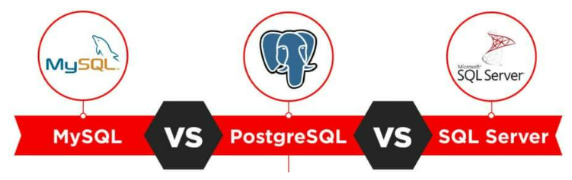
Comparison (MySQL vs PostgreSQL vs SQL SERVER)

Slide 15
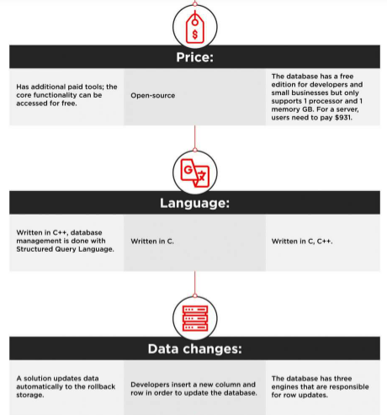

Slide 16
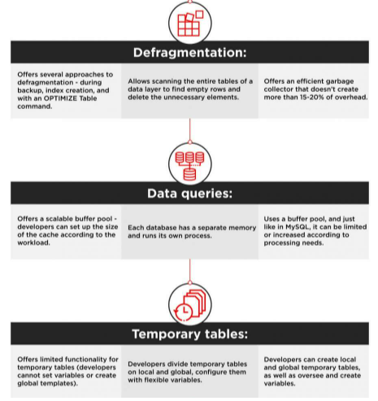

Slide 17
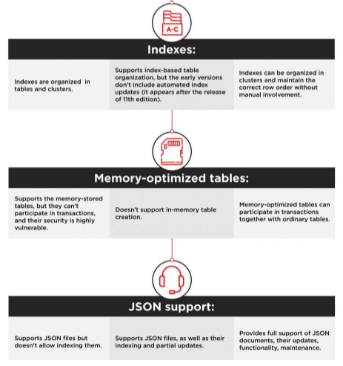

Slide 18
